Slide 1
Math operations

Slide 2
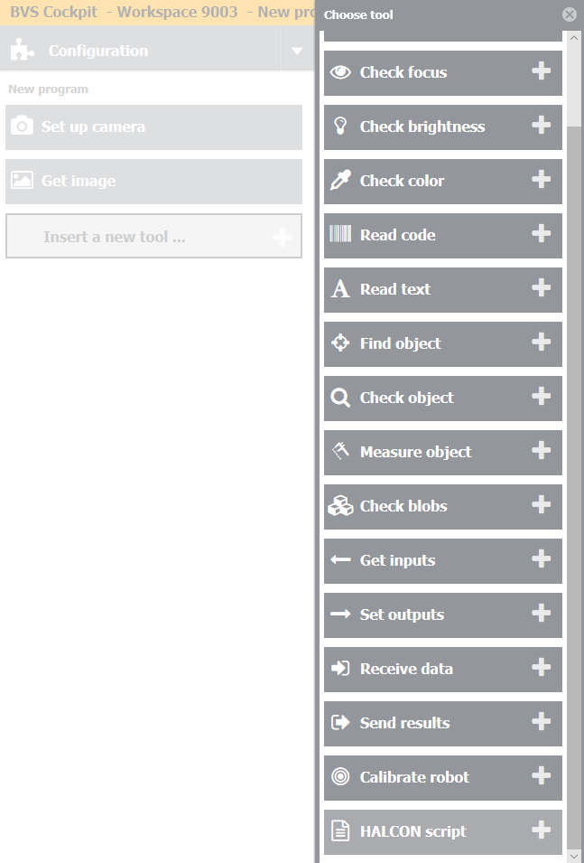
Step 1
Add new tool – Halcon Script – in your inspection program.

Slide 3
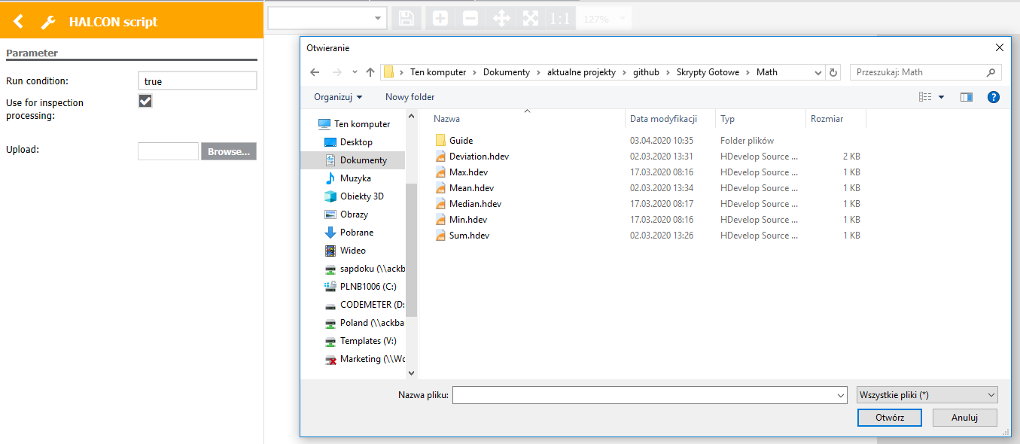
Step 2
Click „Browse” and choose proper „ .hdev” file.
It is possible to make following Math calculations:
Minimum
Maximum
Mean
Median
Sum
Deviation

Slide 4
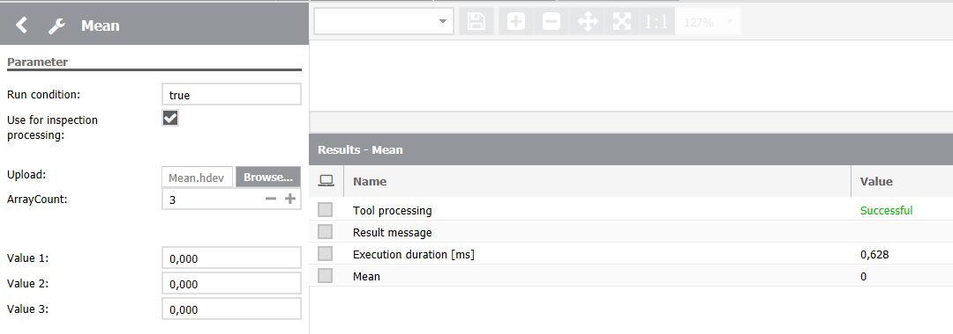
Step 3
Set the number of input parameters.

Slide 5
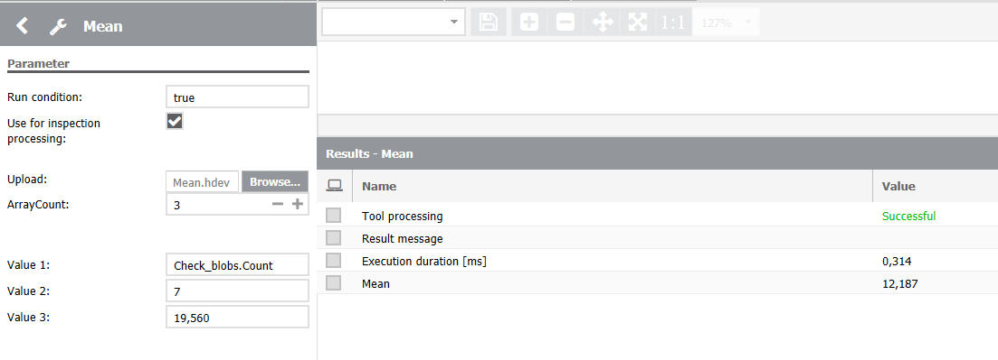
Step 4
Set the values – it is possible to link the input parameter to the output from previous tools.
Calculated value will be in output variable – depending on the type of Math operation.

